Slide 1
PRESENTATION ON MANAGEMENT SYSTEM FOR C.N RETAIL STORE
BY:
NII ADOKWEI ADDO
DIT1535023
CICERO NANA KWAME OFORI BERKO
DIT0001223

Slide 2
CONTENTS
Introduction
Tables in the database
Tables in the database cont’d
Case diagram
Workflow diagram

Slide 3
Introduction
This system we are developing is to take the aspects of retail and implement them into a computerized system in order to make the work of retailers easier and to make transactions faster and time saving. It is also to ensure accuracy, cost-effectiveness and easy data access. The implementation of this system would also ensure that the data is secure when storing rather than it being recorded on paper which is easier to lose or damage. In addition to the data being secure it will also ensure it’s reliable.

Slide 4
Tables in the Database
Categories
id INT(11) PRIMARY KEY AUTO_INCREMENT,
name VARCHAR(60) NOT NULL,
Products
id INT(11) PRIMARY KEY AUTO_INCREMENT,
name VARCHAR(255) NOT NULL,
quantity VARCHAR(50),
buy_price DECIMAL(25,2),
sale_price DECIMAL(25,2) NOT NULL,
date DATETIME NOT NULL ON UPDATE CURRENT_TIMESTAMP,
categorie_id INT(11) FOREIGN KEY REFERENCES categories (id)
User_groups
id INT(11) PRIMARY KEY AUTO_INCREMENT,
Group_name VARCHAR(150) NOT NULL,
Group_level INT (11) NOT NULL,
Group_status INT(1) NOT NULL

Slide 5
Tables in the database cont’d
Sales
id INT(11) PRIMARY KEY AUTO_INCREMENT,
product_id INT(11) FOREIGN KEY REFERENCES products (id),
qty int(11) NOT NULL,
Price DECIMAL(25,2) NOT NULL,
date DATE NOT NULL
Users
id INT(11) PRIMARY KEY AUTO_INCREMENT,
name VARCHAR(60) NOT NULL,
Username VARCHAR(50) NOT NULL,
Password VARCHAR(255) NOT NULL,
User_level INT(11) NOT NULL,
Status INT(1) NOT NULL,
Last_login DATETIME

Slide 6
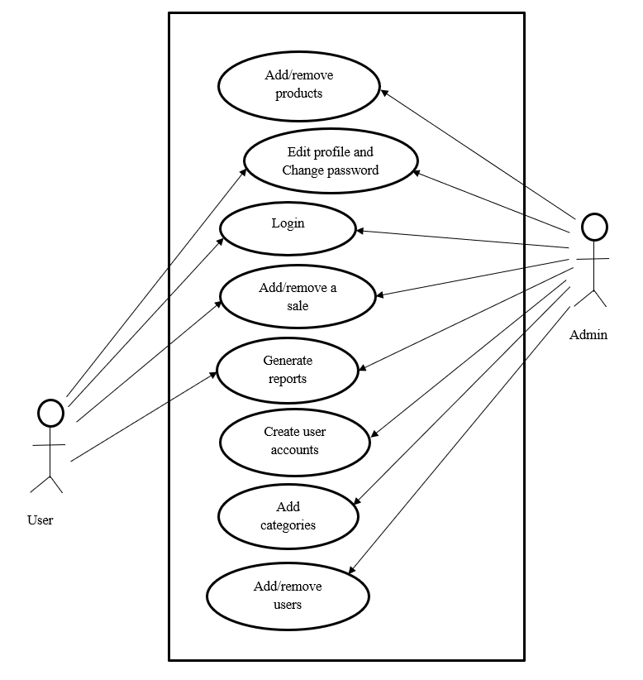
Case Diagram

Slide 7
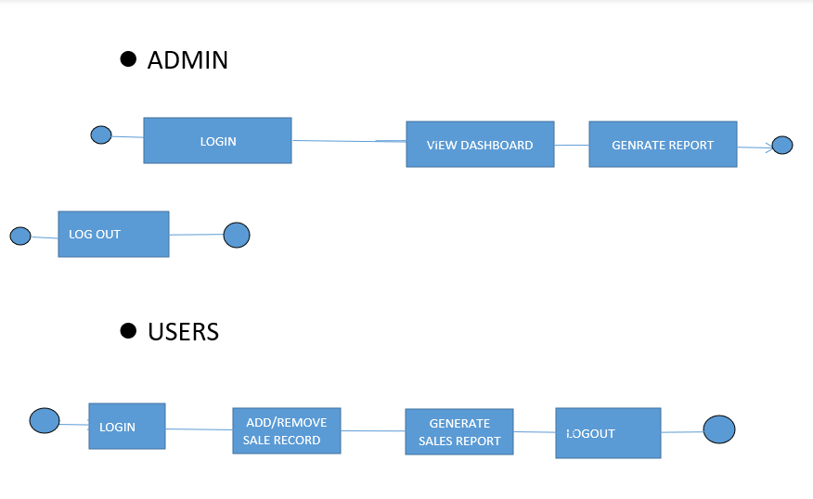
WORK FLOW DIAGRAM

